Slide 1

Chapter 2 How to structure a web application with the MVC pattern
Th.S Mai Hà Thi
UNIVERSITY OF SCIENCE AND EDUCATION
The University of Da Nang

Slide 2
Objectives
Knowledge
Describe the Model 1 pattern.
Describe the Model 2 (MVC) pattern.
Explain how the MVC pattern can improve application development.
Distinguish between the HTML and CSS for a web page.
Distinguish between the code for a servlet and a JSP.
Explain why you typically use both servlets and JSPs in a Java web application.
Describe the purpose of the deployment descriptor in a web application.
Describe the purpose of a JavaBean with a web application.
UNIVERSITY OF SCIENCE AND EDUCATION
The University of Da Nang

Slide 3
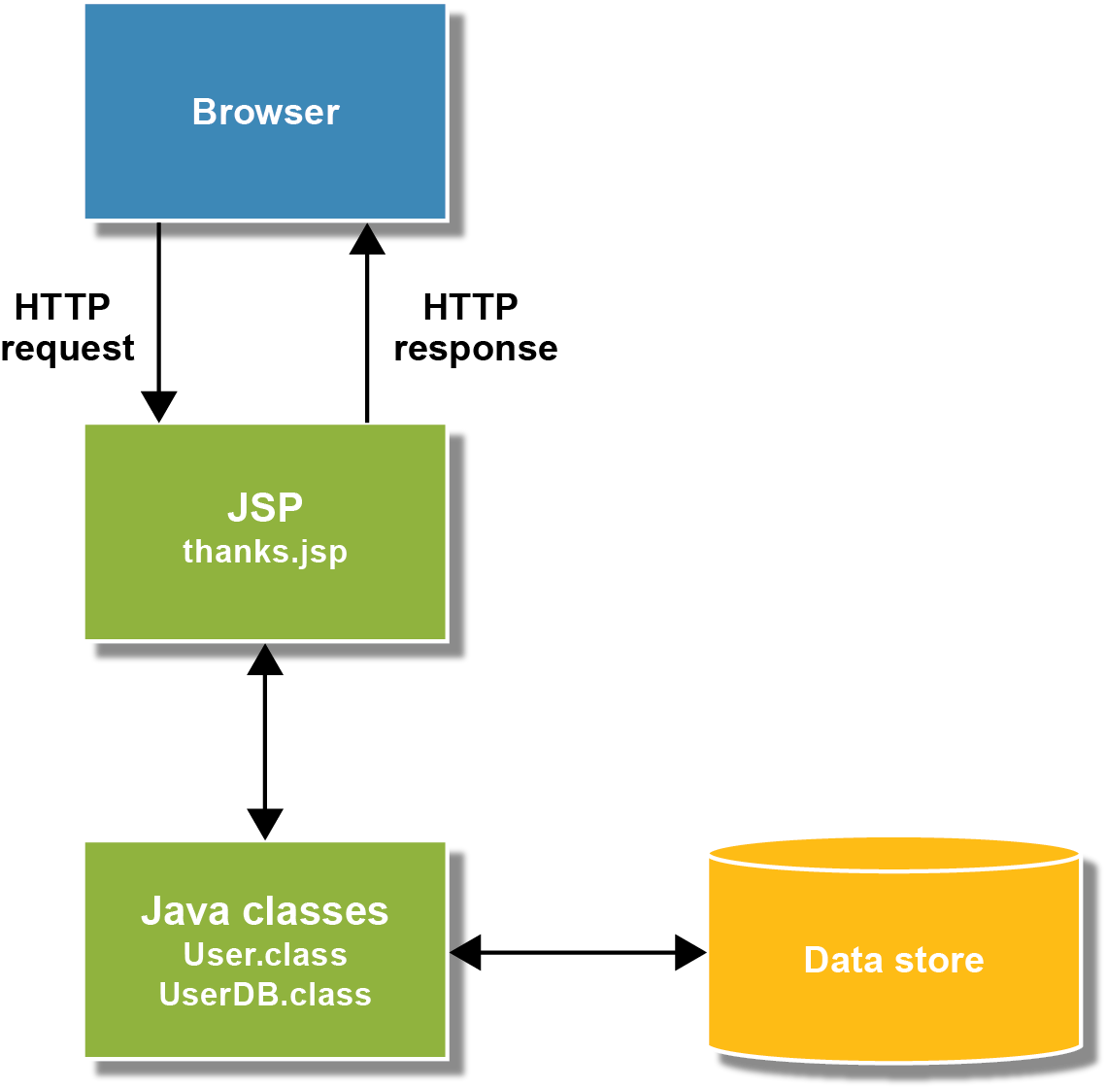
The Model 1 pattern
UNIVERSITY OF SCIENCE AND EDUCATION
The University of Da Nang

Slide 4
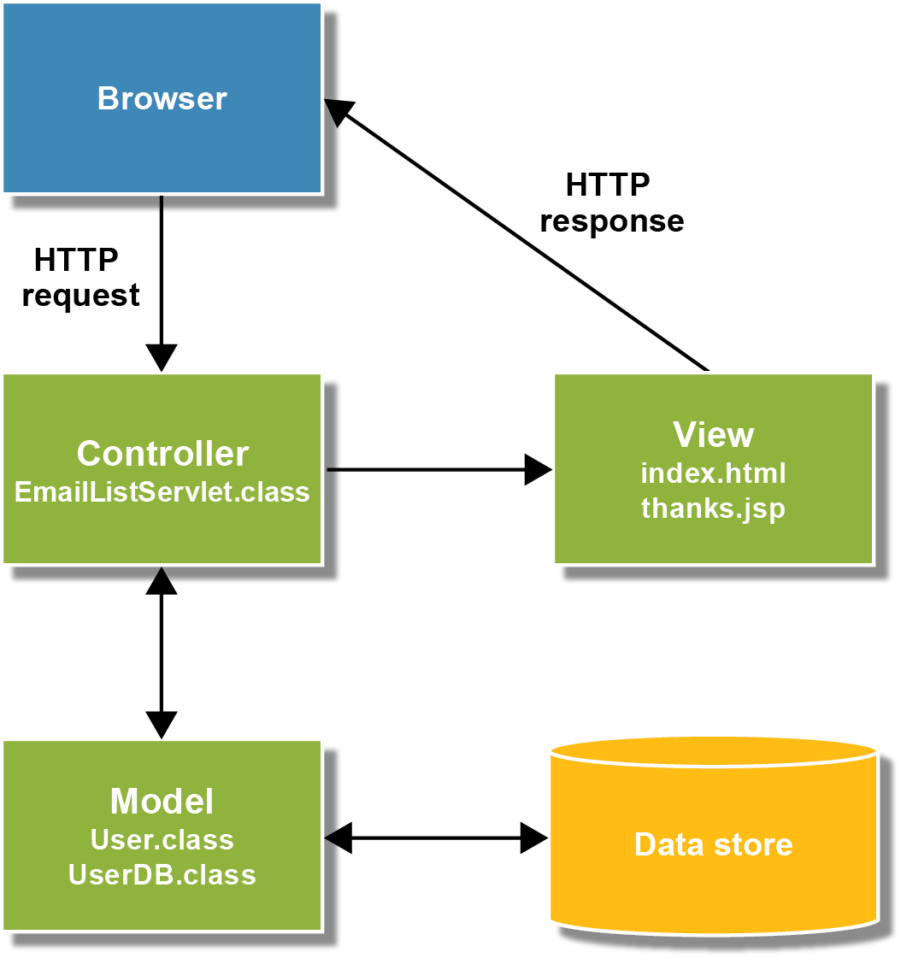
The Model 2 (MVC) pattern
UNIVERSITY OF SCIENCE AND EDUCATION
The University of Da Nang

Slide 5
Concepts and terminology
The Model 1 pattern uses JSPs to handle all of the processing and presentation for the application.
The Model 2 pattern separates the code into a model, a view, and a controller. As a result, it’s also known as the Model-View-Controller (MVC) pattern.
The model consists of business objects like the User object.
The view consist of HTML pages and JSPs.
The controller consists of servlets.
The data access layer consists of classes like the UserDB class that read and write business objects like the User object to and from the data store.
Try to construct each layer so it’s as independent as possible.
UNIVERSITY OF SCIENCE AND EDUCATION
The University of Da Nang

Slide 6
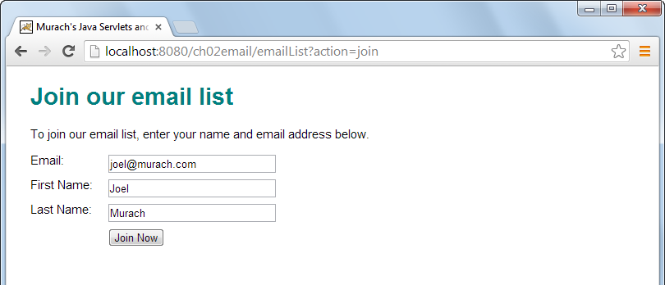
The HTML page that gets data from the user
UNIVERSITY OF SCIENCE AND EDUCATION
The University of Da Nang

Slide 7
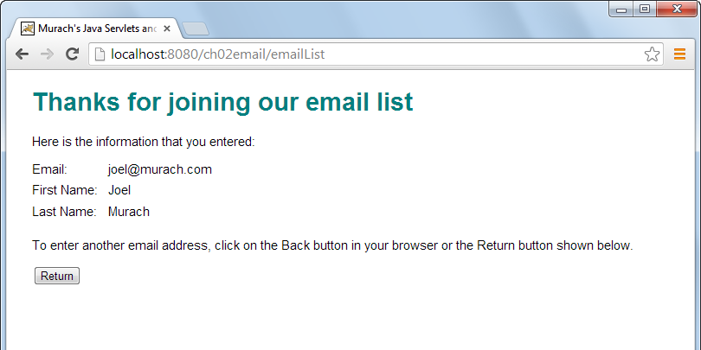
The JSP that displays the data
UNIVERSITY OF SCIENCE AND EDUCATION
The University of Da Nang

Slide 8
The index.html file
UNIVERSITY OF SCIENCE AND EDUCATION
The University of Da Nang

Slide 9
The index.html file (continued)
UNIVERSITY OF SCIENCE AND EDUCATION
The University of Da Nang

Slide 10
The main.css file
UNIVERSITY OF SCIENCE AND EDUCATION
The University of Da Nang

Slide 11
The EmailListServlet class
UNIVERSITY OF SCIENCE AND EDUCATION
The University of Da Nang

Slide 12
The EmailListServlet class (continued)
UNIVERSITY OF SCIENCE AND EDUCATION
The University of Da Nang

Slide 13
The EmailListServlet class (continued)
UNIVERSITY OF SCIENCE AND EDUCATION
The University of Da Nang

Slide 14
The web.xml file
UNIVERSITY OF SCIENCE AND EDUCATION
The University of Da Nang

Slide 15
The web.xml file (continued)
UNIVERSITY OF SCIENCE AND EDUCATION
The University of Da Nang

Slide 16
The User class
UNIVERSITY OF SCIENCE AND EDUCATION
The University of Da Nang

Slide 17
The User class (continued)
UNIVERSITY OF SCIENCE AND EDUCATION
The University of Da Nang

Slide 18
The thanks.jsp file
UNIVERSITY OF SCIENCE AND EDUCATION
The University of Da Nang

Slide 19
The thanks.jsp file (continued)
UNIVERSITY OF SCIENCE AND EDUCATION
The University of Da Nang

Slide 20
Types of files in the MVC pattern
An HTML file contains tags that define the content of the web page.
A CSS (Cascading Style Sheet) file contains for the formatting for the web pages.
Servlets contain Java code for a web application. When a servlet controls the flow of the application, it’s known as a controller.
The web.xml file, or deployment descriptor (DD), describes how the web application should be configured when it’s deployed.
A JavaBean, or bean, is a Java class that (1) provides a zero-argument constructor, (2) provides get and set methods for all of its instance variables, and (3) implements the Serilizable or Externalizable interface.
A JavaServer Page (JSP) consists of special Java tags such as Expression Language (EL) tags that are embedded within HTML code. An EL tag begins with a dollar sign ($).
UNIVERSITY OF SCIENCE AND EDUCATION
The University of Da Nang

Slide 21
Summary
The Model 1 pattern uses JSPs to handle all of the processing and presentation for the application. It’s generally considered a bad practice.
The Model 2 pattern, also known as the Model-View-Controller (MVC) pattern, uses business objects to define the model, HTML pages and JSPs to define the view, and servlets to act as the controller.
The data for the business objects in a web application are stored in data stores like files and databases. This can be referred to as persistent data storage. To work with the data store, you typically use a data access class.
An HTML file contains ta tags that define the content of the web page and a CSS (Cascading Style Sheet) file contains the formatting for the web pages.
A servlet is a special type of Java class that runs on a server and does the processing for the dynamic web pages of a web application.
UNIVERSITY OF SCIENCE AND EDUCATION
The University of Da Nang

Slide 22
Summary (continued)
A web.xml file describes how a web applicatin should be configured when it is deployed on a server. As result, it’s known as the deployment descriptor (DD).
A JavaBean, or bean, is a Java class that (1) provides a zero-argument constructor, (2) provides get and set methods for all f its private instance variables, and (3) implements the Serializable or Externalizable interface.
An Enterprise JavaBean (EJB) is similar in some ways to a regular JavaBean. However, EJBs are more complex and difficult to code than JavaBeans and aren’t necessary for most websites
Since JavaBeans are just Java classes, they are a type of plain old Java object (POJO).
A JavaServer Page (JSP) consists of special Java tags such as Expression Language (EL) tags that are embedded within HTML code. An EL tag begins with a dollar sign ($).
UNIVERSITY OF SCIENCE AND EDUCATION
The University of Da Nang

Slide 23
Lab 2
Each group needs to have a group website.
Use dot.tk to get a domain name such as jsp2020group01.tk if your group is 01…
Suggest all the functions that you think it’s suitable for the project that your group chose in Lab 1.
Write all the functions that you suggest and take a photo of your hand-writing to use later.
And discuss with your group to choose the best ones. Need to have at least 15 functions.
UNIVERSITY OF SCIENCE AND EDUCATION
The University of Da Nang

